Slide 1
Unit 1-3
Measuring Segments
PLANE Geometry

Slide 2
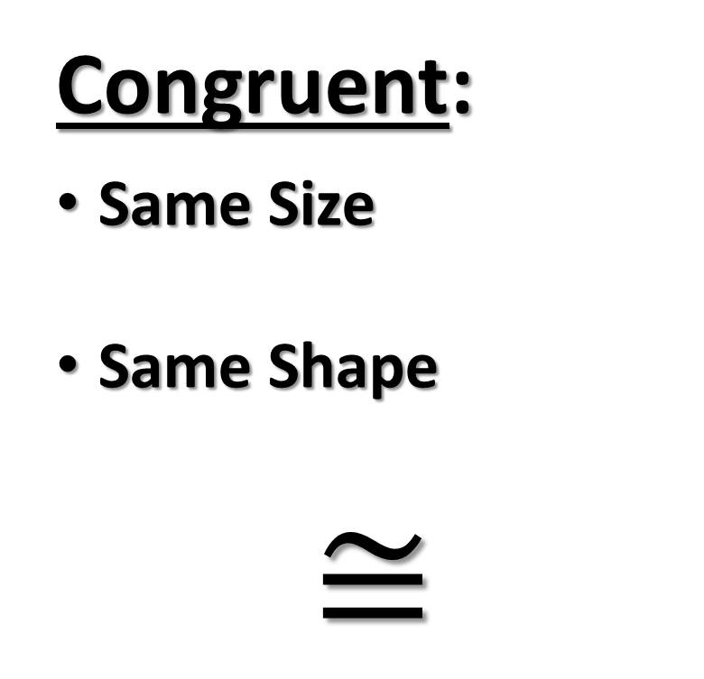

Congruent:
Same Size
Same Shape
$$≅$$
Congruent Segments:
Same Length
C
D

Slide 3
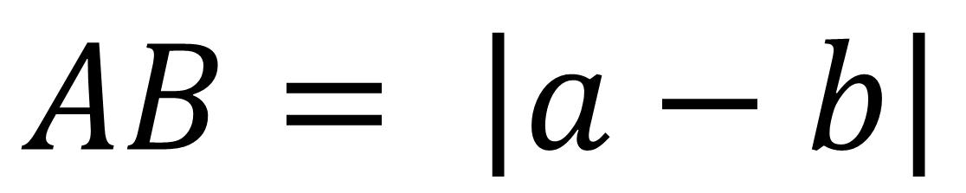
Ruler Postulate:
The distance (a positive number) between A and B equals the absolute value of their difference.
$$AB= \left|a−b\right|$$
a
b
A
B

Slide 4

Example 1
Find the lengths of the given segment.
AC AD BC CD BE

Slide 5
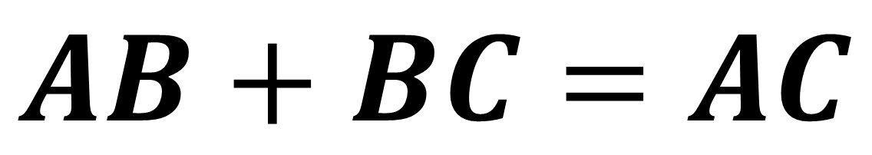
Segment Addition:
3 Collinear Points A, B, and C
B is between A and C
A
B
C
$$AB+BC=AC$$

Slide 6
Example 2
Find the lengths of the given segment.
18
21
13
A
B
C
A
B
C
25
AC =
BC =

Slide 7
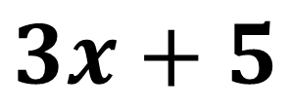
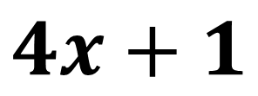
Example 3
$$3x+5$$
$$4x+1$$
A
B
C
34
x =
AB =
BC =

Slide 8
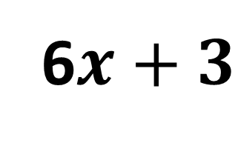
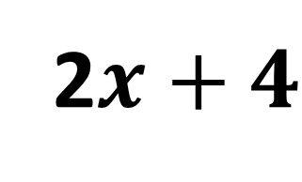
Example 4
6$x+3$
2$x+4$
A
B
C
31
x =
AB =
BC =

Slide 9

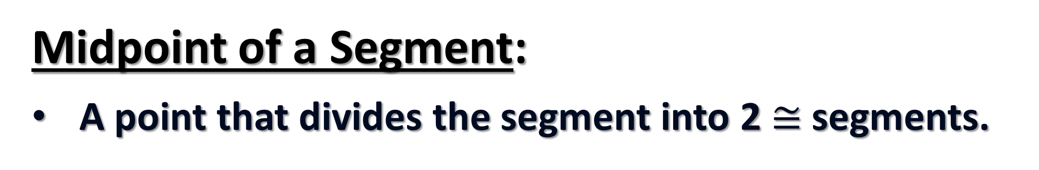
Midpoint of a Segment:
A point that divides the segment into 2 $≅$ segments.
A
B
C
$\overline{AB}≅$ $\overline{BC}$

Slide 10
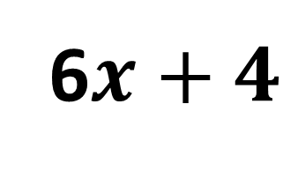

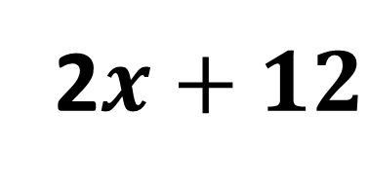
Example 5
B is the Midpoint of $\overline{AC}$.
6$x+4$
2$x+12$
A
B
C
x =
AB =
AC =

Slide 11
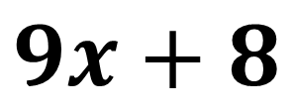
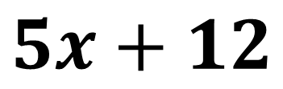
Example 6
B is the Midpoint of $\overline{AC}$.
$$9x+8$$
$$5x+12$$
A
B
C
x =
AB =
AC =

